Slide 1
Blockchain Technology 3
Beni Iyaka H00181266
bi34@hw.ac.uk
MSc Software Engineering
2016 - 2017

Slide 2
Outline
Overview
Transaction
Bitcoin Mining
Bitcoin Payment
Payment Protocol
Bitcoin Payment Verification
Conclusion
Further Readings

Slide 3
Transaction
(Alice & Bob Scenario)

Slide 4
Alice uses to send Bob a transaction and which Bob later uses to spend that transaction
Both Alice and Bob will use the most common form of the standard Pay-To-Public-Key-Hash (P2PKH) transaction type
Bob must first generate a private/public key pair before Alice can create the first transaction
Bitcoin uses the Elliptic Curve Digital Signature Algorithm (ECDSA) with the secp256k1 curve
secp256k1 private keys are 256 bits of random data
Barber, S., Boyen, X., Shi, E. and Uzun, E., 2012, February. Bitter to better—how to make bitcoin a better currency. In International Conference on Financial Cryptography and Data Security (pp. 399-414). Springer Berlin Heidelberg.

Slide 5
A copy of that data is deterministically transformed into an secp256k1 public key.
The public key (pubkey) is then cryptographically hashed
Bob provides the pubkey hash to Alice
Pubkey hashes are almost always sent encoded as Bitcoin addresses, which are base58-encoded strings
containing an address version number, the hash, and an error-detection checksum
Barber, S., Boyen, X., Shi, E. and Uzun, E., 2012, February. Bitter to better—how to make bitcoin a better currency. In International Conference on Financial Cryptography and Data Security (pp. 399-414). Springer Berlin Heidelberg.

Slide 6
Once Alice has the address and decodes it back into a standard hash, she can create the first transaction
A standard P2PKH transaction output containing instructions(are called the pubkey script or scriptPubKey)
Alice broadcasts the transaction and it is added to the block chain.
The network categorizes it as an Unspent Transaction Output (UTXO)
Some time later, Bob decides to spend the UTXO, he must create an input which references the transaction Alice created by its hash, called a Transaction Identifier (txid)
Barber, S., Boyen, X., Shi, E. and Uzun, E., 2012, February. Bitter to better—how to make bitcoin a better currency. In International Conference on Financial Cryptography and Data Security (pp. 399-414). Springer Berlin Heidelberg.

Slide 7
Create a signature script—a collection of data parameters which satisfy the conditions Alice placed in the previous output’s pubkey script.
Signature scripts are also called scriptSigs
Barber, S., Boyen, X., Shi, E. and Uzun, E., 2012, February. Bitter to better—how to make bitcoin a better currency. In International Conference on Financial Cryptography and Data Security (pp. 399-414). Springer Berlin Heidelberg.

Slide 8
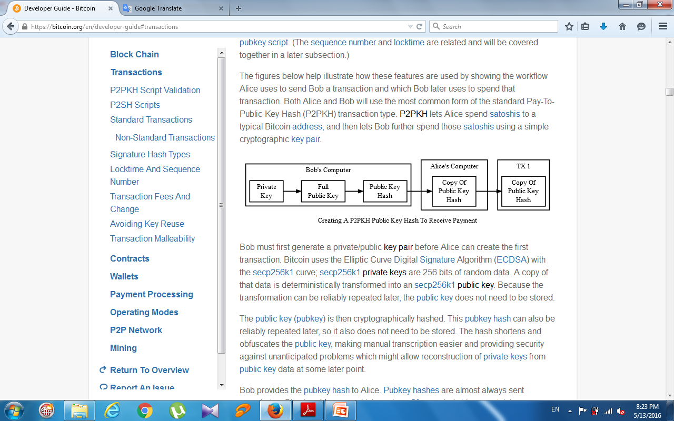
Barber, S., Boyen, X., Shi, E. and Uzun, E., 2012, February. Bitter to better—how to make bitcoin a better currency. In International Conference on Financial Cryptography and Data Security (pp. 399-414). Springer Berlin Heidelberg.

Slide 9
Alice broadcasts the transaction and it is added to the block chain. The network categorizes it as an Unspent Transaction Output (UTXO), and Bob’s wallet software displays it as a spendable balance.
some time later, Bob decides to spend the UTXO, he must create an input which references the transaction Alice created by its hash, called a Transaction Identifier (txid)
create a signature script—a collection of data parameters which satisfy the conditions Alice placed in the previous output’s pubkey script. Signature scripts are also called scriptSigs
Barber, S., Boyen, X., Shi, E. and Uzun, E., 2012, February. Bitter to better—how to make bitcoin a better currency. In International Conference on Financial Cryptography and Data Security (pp. 399-414). Springer Berlin Heidelberg.

Slide 10
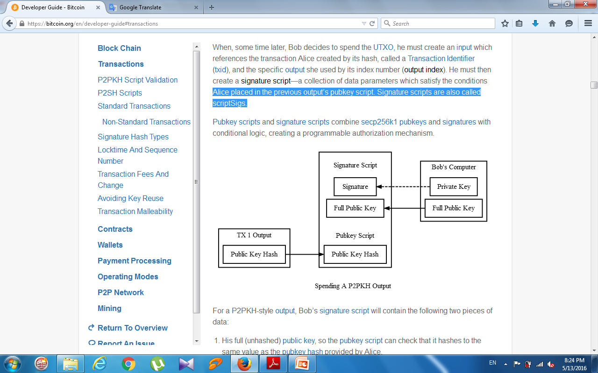
Barber, S., Boyen, X., Shi, E. and Uzun, E., 2012, February. Bitter to better—how to make bitcoin a better currency. In International Conference on Financial Cryptography and Data Security (pp. 399-414). Springer Berlin Heidelberg.

Slide 11
Bitcoin Wallet

Slide 12
Wallet programs create public keys to receive satoshis and use the corresponding private keys to spend those satoshis
Wallet programs also need to interact with the peer-to-peer network to get information from the block chain and to broadcast new transactions
three necessary, but separable, parts of a wallet system:
public key distribution program
signing program
networked program
Decker, C. and Wattenhofer, R., 2013, September. Information propagation in the bitcoin network. In IEEE P2P 2013 Proceedings (pp. 1-10). IEEE.

Slide 13
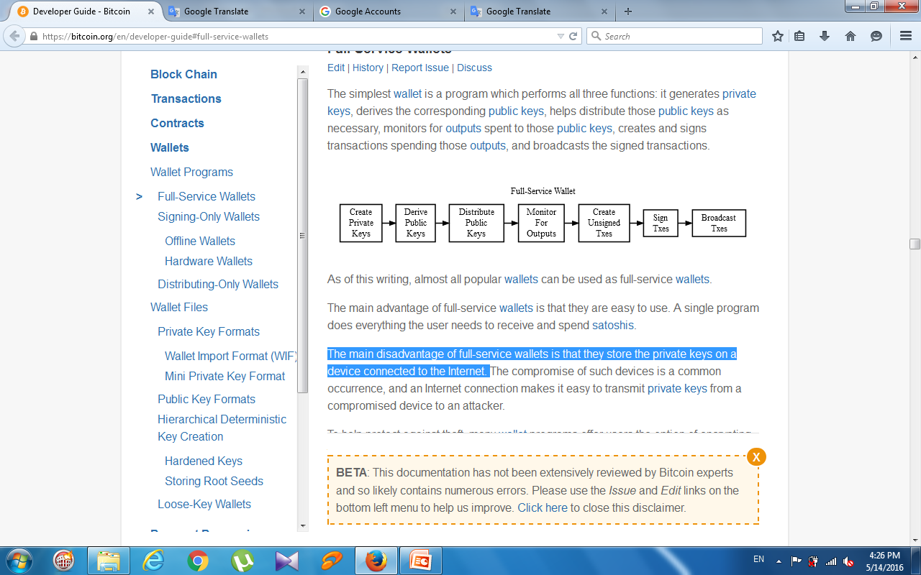
Full-Service Wallets
The simplest wallet is a program which performs all three functions
almost all popular wallets can be used as full-service wallets
The main advantage of full-service wallets is that they are easy to use
The main disadvantage of full-service wallets is that they store the private keys on a device connected to the Internet
Decker, C. and Wattenhofer, R., 2013, September. Information propagation in the bitcoin network. In IEEE P2P 2013 Proceedings (pp. 1-10). IEEE.

Slide 14
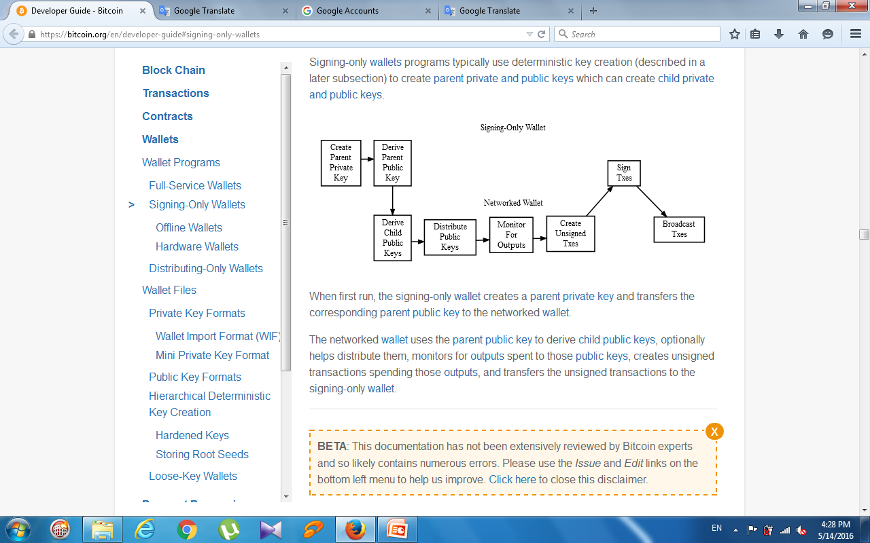
Signing-Only Wallets
To increase security, private keys can be generated and stored by a separate wallet program operating in a more secure environment
These signing-only wallets work in conjunction with a networked wallet which interacts with the peer-to-peer network.
Decker, C. and Wattenhofer, R., 2013, September. Information propagation in the bitcoin network. In IEEE P2P 2013 Proceedings (pp. 1-10). IEEE.

Slide 15
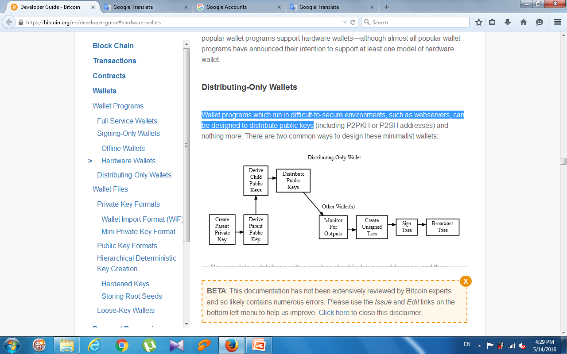
Distributing-Only Wallets
Wallet programs which run in difficult-to-secure environments, such as webservers, can be designed to distribute public keys
Decker, C. and Wattenhofer, R., 2013, September. Information propagation in the bitcoin network. In IEEE P2P 2013 Proceedings (pp. 1-10). IEEE.

Slide 16

Bitcoin Mining

Slide 17
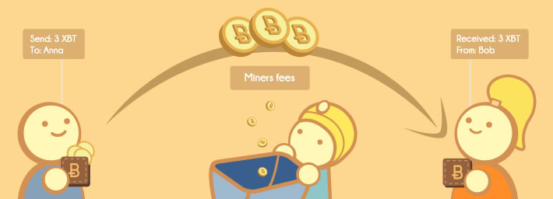
The process of finding a valid block
(adds new blocks to the block chain)
Nodes that mine are called miners
Perform this steps in an endless loop:
Collect all broadcasted transactions and validate whether they satisfy the miner's self-defined policy
Decker, C. and Wattenhofer, R., 2013, September. Information propagation in the bitcoin network. In IEEE P2P 2013 Proceedings (pp. 1-10). IEEE.

Slide 18
The process of finding a valid block (adds new blocks to the block chain)
Nodes that mine are called miners
Perform this steps in an endless loop:
Collect all broadcasted transactions and validate whether they satisfy the miner's self-defined policy
Verify all transactions that are to be included in the block and it is checked whether they have been previously spent
Select the most recent block on the longest path in the blockchain
Attempt to solve the proof-of-work problem and broadcast the solution

Slide 19
Miners use software that accesses their processing capacity to solve transaction-related algorithms .
In return, they are awarded a certain number of Bitcoins per block
Its mining hardware (an ASIC) along with a target threshold (difficulty setting).
Decker, C. and Wattenhofer, R., 2013, September. Information propagation in the bitcoin network. In IEEE P2P 2013 Proceedings (pp. 1-10). IEEE.

Slide 20
The mining hardware iterates through every possible value for the block header nonce and generates the corresponding hash
If a hash is found below the target threshold, the mining hardware returns the block header with the successful nonce to the mining software.
The mining software combines the header with the block and broadcasts to the network for addition to the block chain
Decker, C. and Wattenhofer, R., 2013, September. Information propagation in the bitcoin network. In IEEE P2P 2013 Proceedings (pp. 1-10). IEEE.

Slide 21
Bitcoin Payment

Slide 22
Payment processing encompasses the steps senders and receivers perform to make and accept payments in exchange for products or services
The Payment Protocol is described in depth in BIP70, BIP71, and BIP72
Grinberg, R., 2012. Bitcoin: An innovative alternative digital currency. Hastings Sci. & Tech. LJ, 4, p.159.

Slide 23
New payment protocol adds many important features :
Supports X.509 certificates and SSL encryption to verify receivers’ identity and help prevent man-in-the-middle attacks.
Allows spenders to submit transactions directly to receivers without going through the peer-to-peer network
Bluetooth-based payments
Instead of a meaningless address (mjSk1Ny9spzU2fouzYgLqGUD8U41iR35QN), Common Name (CN) description from the receiver’s X.509 certificate (www.bitcoin.org)
Grinberg, R., 2012. Bitcoin: An innovative alternative digital currency. Hastings Sci. & Tech. LJ, 4, p.159.

Slide 24
Payment Protocol

Slide 25
Charlie, the client, is shopping on a website run by Bob
Charlie adds a few items to his shopping cart and clicks the “Checkout With Bitcoin” button.
Bob’s server automatically adds the following information to its invoice database:
The details of Charlie’s order, including items ordered and shipping address.
An order total in satoshis
An expiration time when that total will no longer be acceptable.
A pubkey script to which Charlie should send payment.
After adding all that information to the database, Bob’s server displays a bitcoin: URI for Charlie to click to pay

Slide 26
Charlie clicks on the bitcoin: URI in his browser
His browser’s URI handler sends the URI to his wallet program
Wallet sends an HTTP GET to that URL looking for a PaymentRequest message
The PaymentRequest message returned may include private information, such as Charlie’s mailing address
The unique public key created for the payment request can be used to create a unique identifier

Slide 27
After receiving the HTTP GET to the URL, Bob’s webserver takes the unique identifier from the URL and looks up the corresponding details in the database.
creates a PaymentDetails message with information:
The amount of the order in satoshis and the pubkey script to be paid
A memo containing the list of items ordered
The time the PaymentDetails message was created plus the time it expires
A URL to which Charlie’s wallet should send its completed transaction
Grinberg, R., 2012. Bitcoin: An innovative alternative digital currency. Hastings Sci. & Tech. LJ, 4, p.159.

Slide 28
That PaymentDetails message is put inside a PaymentRequest message.
Bob’s server sign the entire Request with the server’s X.509 SSL certificate.
Bob’s server sends the payment request to Charlie’s wallet in the reply to the HTTP GET

Slide 29
Charlie’s wallet receives the PaymentRequest message, checks its signature, and then displays the details to Charlie
Charlie agrees to pay, the wallet constructs a payment to the pubkey script Bob’s server provided
Constructs a Payment message and sends it to the URL provided in the PaymentDetails message as an HTTP POST which contains:
The signed transaction in which Charlie pays Bob
An optional memo Charlie can send to Bob
A refund address (pubkey script) which Bob can pay if he needs to return some or all of Charlie’s satoshis

Slide 30
Bob’s server receives the Payment message, verifies the transaction, then broadcasts the transaction to the network.
Replies to the HTTP POSTed Payment message with a PaymentACK message
Charlie’s wallet sees the PaymentACK and tells Charlie that the payment has been sent
Grinberg, R., 2012. Bitcoin: An innovative alternative digital currency. Hastings Sci. & Tech. LJ, 4, p.159.

Slide 31
The PaymentACK doesn’t mean that Bob has verified Charlie’s payment
After Bob’s server verifies from the block chain that Charlie’s transaction has been suitably confirmed, it authorizes shipping Charlie’s order
Grinberg, R., 2012. Bitcoin: An innovative alternative digital currency. Hastings Sci. & Tech. LJ, 4, p.159.

Slide 32
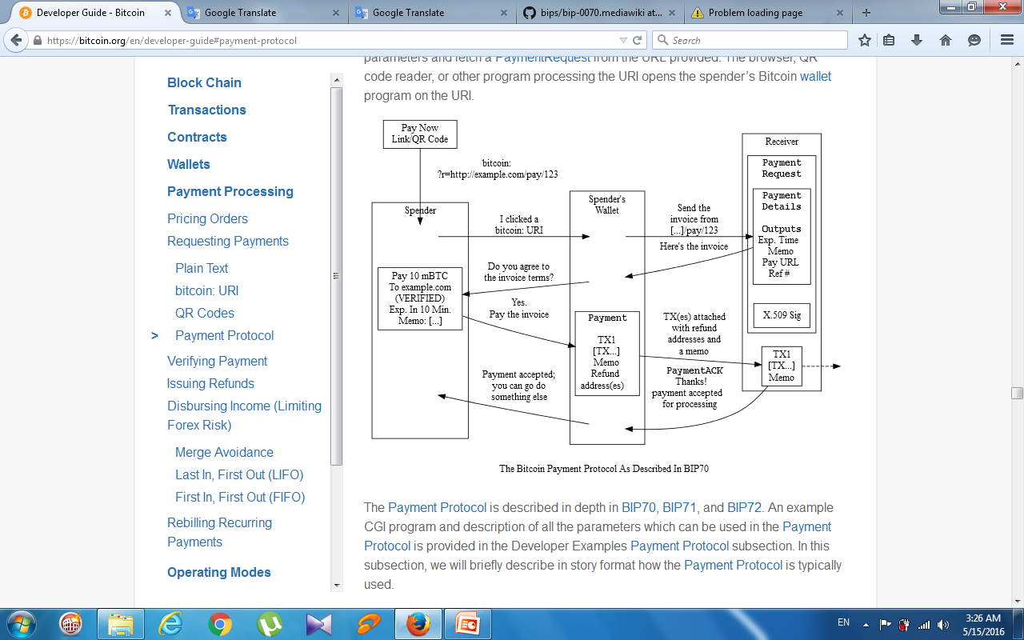

Slide 33
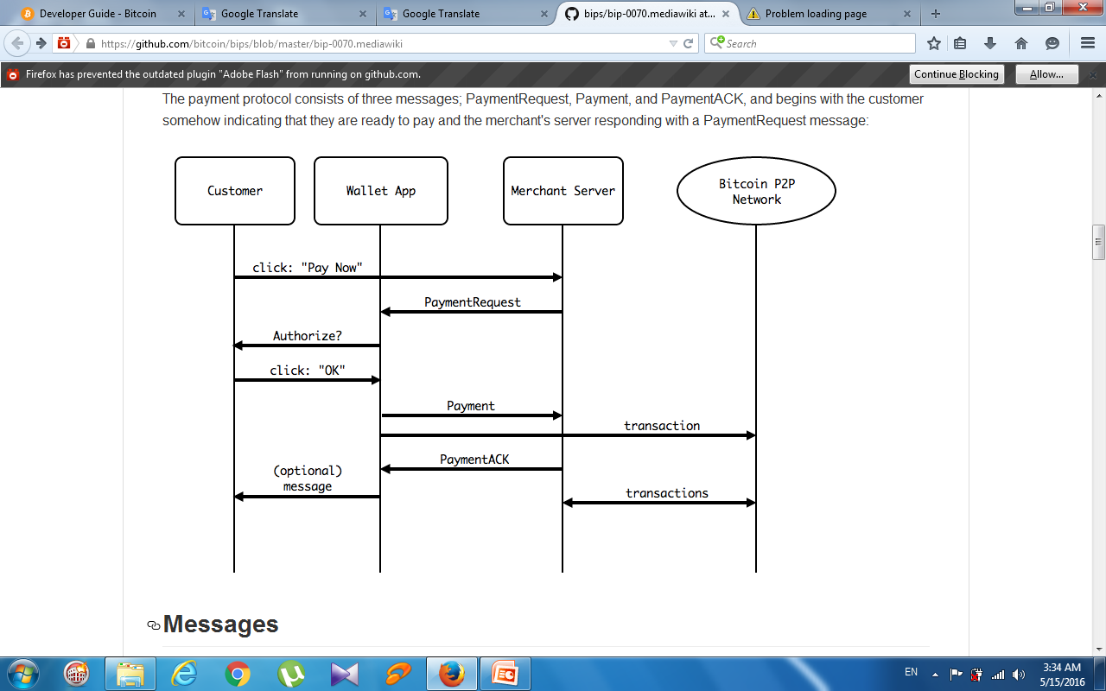
Grinberg, R., 2012. Bitcoin: An innovative alternative digital currency. Hastings Sci. & Tech. LJ, 4, p.159.

Slide 34
Bitcoin Payment Verification

Slide 35
0 confirmations (unconfirmed transactions)
The transaction has been broadcast but is still not included in any block
should generally not be trusted without risk analysis
Miners usually confirm the first transaction they receive, fraudsters may be able to manipulate the network into including their version of a transaction.
1 confirmation
The transaction is included in the latest block and double-spend risk decreases dramatically
Transactions which pay sufficient transaction fees need 10 minutes on average to receive one confirmation
The most recent block gets replaced fairly often by accident, so a double spend is still a real possibility

Slide 36
2 confirmations
The most recent block was chained to the block which includes the transaction
As of March 2014, two block replacements were exceedingly rare, and a two block replacement attack was impractical without expensive mining equipment.
6 confirmations
The network has spent about an hour working to protect the transaction against double spends and the transaction is buried under six blocks
Even a reasonably lucky attacker would require a large percentage of the total network hashing power to replace six blocks

Slide 37
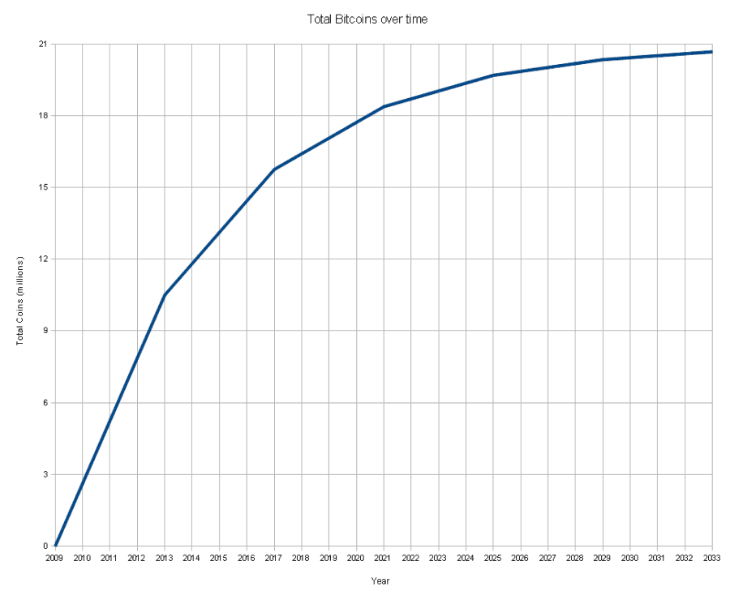
Bitcoin over time
Grinberg, R., 2012. Bitcoin: An innovative alternative digital currency. Hastings Sci. & Tech. LJ, 4, p.159.

Slide 38
Conclusion

Slide 39
It is useful to understand blockchains in the context of bitcoin, but you should not assume that all blockchain ecosystems need bitcoin mechanisms such as tokens, proof of work mining, longest chain rule, etc.
Bitcoin is the first attempt at maintaining a decentralised, public ledger with no formal control or governance.
Ethereum is the next iteration of a blockchain with smart contracts.
There are significant challenges involved.

Slide 40
On the other hand, private or internal distributed ledgers and blockchains can be deployed to solve other sets of problems.
As ever, there are tradeoffs and pros and cons to each solution, and you need to consider these individually for each individual use case.

Slide 41
Further readings
https://bitsonblocks.net/2016/02/01/a-gentle-introduction-to-smart-contracts/
https://bitsonblocks.net/2016/05/09/confused-by-blockchains-revolution-vs-evolution/
https://bitsonblocks.net/2015/12/01/the-pros-and-cons-of-internal-blockchains/

Slide 42
Further readings
https://bitsonblocks.net/2015/09/28/a-gentle-introduction-to-digital-tokens/
https://bitsonblocks.net/2015/09/21/a-gentle-introduction-to-bitcoin-mining/
https://bitsonblocks.net/2016/02/01/a-gentle-introduction-to-smart-contracts/

